Slide 1
Heme Degradation and Jaundice
Prof. Sureka Chackrewarthy
Dept of Biochemistry & Clinical Chemistry
Notes:
Heme is the prosthetic group for hemoglobin, myoglobin, cytochromes, catalase and tryptophan pyrrolase. Heme is catabolised by the reticuloendothelial system particularly in the liver and the spleen.

Slide 2
Catabolism of heme
85% of heme - RBC
Other 15% in hemoglobin, myoglobin, cytochromes, catalase and tryptophan pyrrolase.
Heme is degraded into bilirubin in the reticuloendothelial system, particularly in the liver and spleen.

Slide 3
Degradation of heme
Heme + NADPH + O₂
Fe⁺³ + CO
Biliverdin
Bilirubin
Heme
oxygenase
Biliverdin
reductase

Slide 4
1g of hemoglobin yields 35 mg of bilirubin. The daily bilirubin formation in a human adult is approx. 250 -350 mg.
Free bilirubin is water insoluble and called unconjugated or indirect bilirubin. Free bilirubin immediately combines with plasma albumin and is transported to the liver.

Slide 5
Further metabolism of bilirubin occur in the liver in three stages.
(i) uptake of bilirubin by liver parenchymal cells
(ii) conjugation of bilirubin in the smooth ER
(iii) secretion of conjugated bilirubin into bile

Slide 6
Uptake by liver
Bilirubin – Albumin complex
transported in blood to liver
bilirubin detach from albumin
and taken up by liver cells by
facilitated transport system
conjugation of bilirubin in liver

Slide 7
Bilirubin is detached from albumin at the sinusoidal surface
Taken into hepatocyte by a carrier mediated saturable system (facilitated transport) with a large capacity
Two cytosolic proteins involved in the transport of bilirubin in the hepatocyte
Conjugation at SER

Slide 8
(ii) Conjugation of bilirubin
UDP-Glucose dehydrogenase
UDP-Glucose UDP-glucuronic acid
UDP glucuronyl Bilirubin
transferase
Bilirubin mono glucuronide + UDP
UDP glucuronyl transferase
Bilirubin di glucuronide + UDP
UDPglucuronic acid

Slide 9
(iii) Secretion of conjugated bilirubin
Conjugated (direct) bilirubin secreted into bile. A small amount escapes into blood.
In the intestine bacterial flora converts bilirubin into urobilinogen.
Urobilinogen has two fates.
(a) converted into stercobilinogen and excreted in faeces.

Slide 10
(b) reabsorbed in the ileum. This fraction can either be
excreted via the kidneys
(urine)
resecreted into bile via the liver
(enterohepatic circulation)

Slide 11
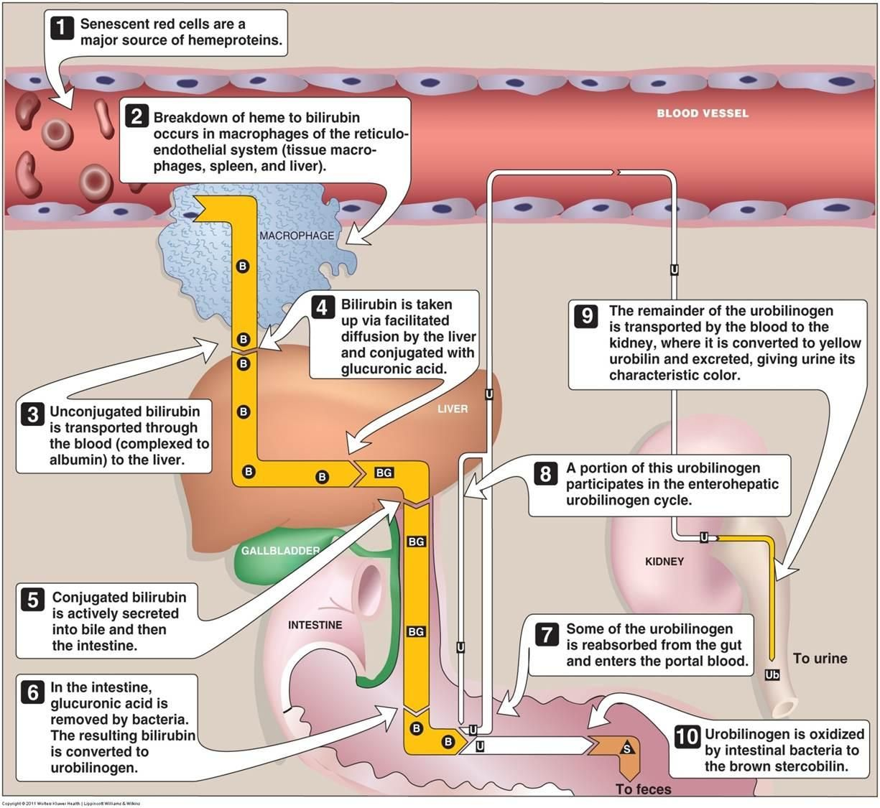

Slide 12
JAUNDICE
Yellowish discoloration of skin, sclera and mucous membranes.
Due to accumulation of unconjugated bilirubin (UCB), conjugated bilirubin (CB) or both (UCB & CB) in blood.
Total bilirubin (UCB + CB) = 0.3-1mg/dl
Hyperbilirubinaemia = 1-2 mg/dl
Jaundice > 2 mg/dl

Slide 13
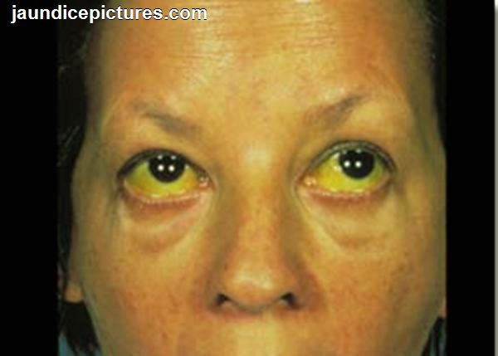
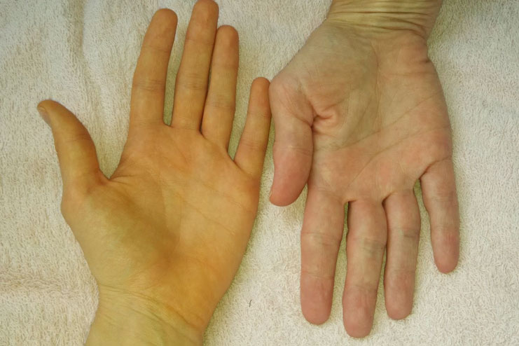

Slide 14
Causes
(i)Excess production of bilirubin – pre hepatic jaundice
(ii)Decreased uptake, conjugation and secretion – hepatic jaundice
(iii)Extrahepatic bile duct obstruction – post hepatic jaundice

Slide 15
Pre-hepatic jaundice (hemolytic)
Eg: hemolytic anaemia
malaria
ABO/Rh incompatibility
thalassaemia
sickle cell anaemia

Slide 16
Features –
Increased hemolysis – increased serum UCB
Liver cell functions normal
Serum CB normal
No bilirubin in urine
Increased urobilinogen in urine
Increased stercobilinogen in feces (dark stools)
Decreased heamoglobin concentration
Increased reticulocyte count

Slide 17
Hepatic jaundice
(a) Sub type A – Congenital, non-hemolytic
hyperbilirubinaemia
Gilbert`s syndrome – low Glucuronyl Transferase activity
Crigler Najjar syndrome –
Type I – No Glu. Tr. activity
Type II – Low Glu. Tr. Activity
Features –
increased serum UCB
decreased serum CB
decreased urobilinogen/ stercobilinogen
liver histology normal

Slide 18
Dubin Jhonson syndrome – defect in secretion of CB into bile
Features-
Serum UCB normal
Serum CB increased
Urobilinogen/stercobilinogen decreased
Bilirubin present in urine
Liver histology – shows melanin deposits

Slide 19
(b) Sub type B –
Intra hepatic cholestasis with abnormal liver function tests.
Eg: viral hepatitis, cirrhosis
Features :
increased UCB in serum
increased CB in serum (CB regurgitates into blood)
decreased urobilonogen in urine
bilirubin present in urine
increased gamma glutamyl transferase (GGT) and alkaline phosphatase (ALP)

Slide 20
(c) Sub type C –
Intra hepatic cholestasis with normal liver function tests.
Eg: Pregnancy, drugs (chloropromazine)
Features – resemble extrahepatic cholestasis

Slide 21
Post hepatic jaundice – (extra hepatic cholestasis)
Due to obstruction of the common bile duct.
Causes –
Stones (gall stones) in the common bile duct
Carcinoma of the head of pancreas
Biliary stricture
Pancreatitis with or without pseudocyst
Enlarged lymph nodes compressing bile ducts
Severe helminthic infections

Slide 22
Features – CB regurgitates into blood.
Serum UCB normal
Serun CB increased
Bilirubin present in urine
Decreased urobilinogen/stercobilinogen
Bile salts present in urine
Serum alkaline phosphatase increased
Effects of prolonged cholestasis – steatorrhoea, decreased absorption of fat soluble vitamins, deposition of bile salts in skin

Slide 23
Neonatal (Physiological) jaundice
Jaundice of the new born
Delay in maturation of bilirubin conjugating enzyme / immature hepatic system
Increased UCB in serum
Treatment – phototherapy (exposure to UV light)
May be serious in premature babies. Increased risk of kernicterus (deposition of bilirubin in brain and spinal cord)

Slide 24
THANK YOU

